Slide 1

Combating Burnout and Cultivating Resilience
Caitlin Wainscott, MD, FAAP
Notes:
My story

Slide 2
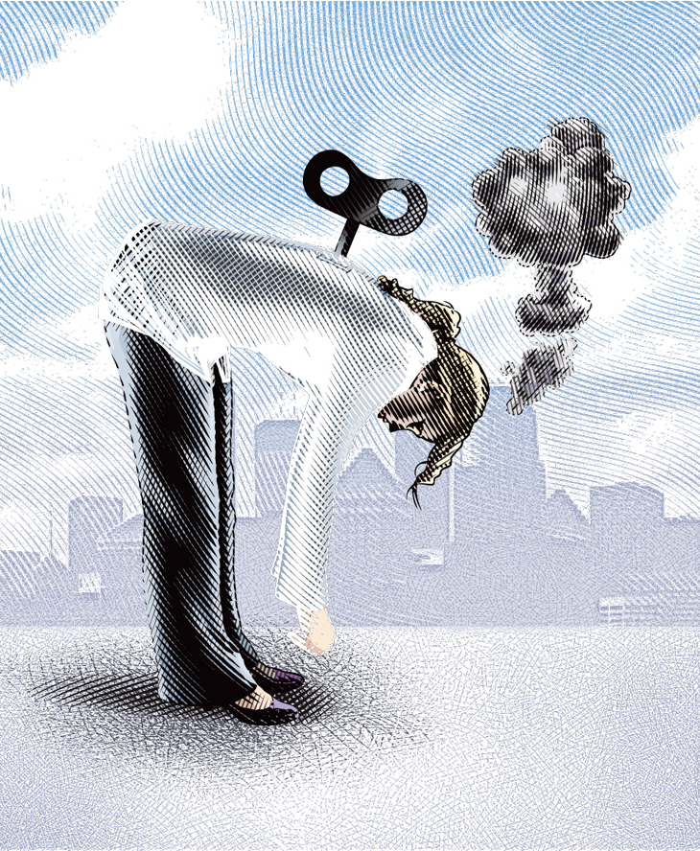
What is Burnout?
Triad of emotional exhaustion, depersonalization, reduced sense of accomplishment¹
Notes:
In response to being constantly faced with difficult situations, physicians first experience emotional exhaustion. This can be a normal stress response to a challenging situation. Exhaustion then prompts one to distance themself emotionally and cognitively from their work. The hallmark of burnout comes when that same physician grows increasingly negative and cynical and begins to withdraw. This is known as depersonalization. They then lose the psychological connection with their work, which has implications for their motivation and identity. This results in poor patient care and reduced self esteem for the physician.

Slide 3
2018 Medscape National Physician Burnout & Depression Report²
42% self-report burnout
12% are colloquially depressed
3% are clinically depressed
Pediatricians fall in the middle with 41% reporting burnout

Slide 4

Why is this Happening?
External factors
  Loss of autonomy, pressure to do more with less, increasing documentation requirements, RVU- and patient satisfaction-based reimbursement, rising student debt, increasing social isolation²
Notes:
Physicians have always worked long hours, and physicians have always had stressful, demanding jobs. It’s the loss of autonomy, the pressure to do more with less, the ever-increasing documentation requirements, RVU- and patient satisfaction-based reimbursement, the rise in student debt, and increasing social isolation as doctor-patient relationships and relationships among colleagues suffer as a result of time constraints, uncertainty about the future, and lack of flexible work options that are causing unprecedented burnout.

Slide 5
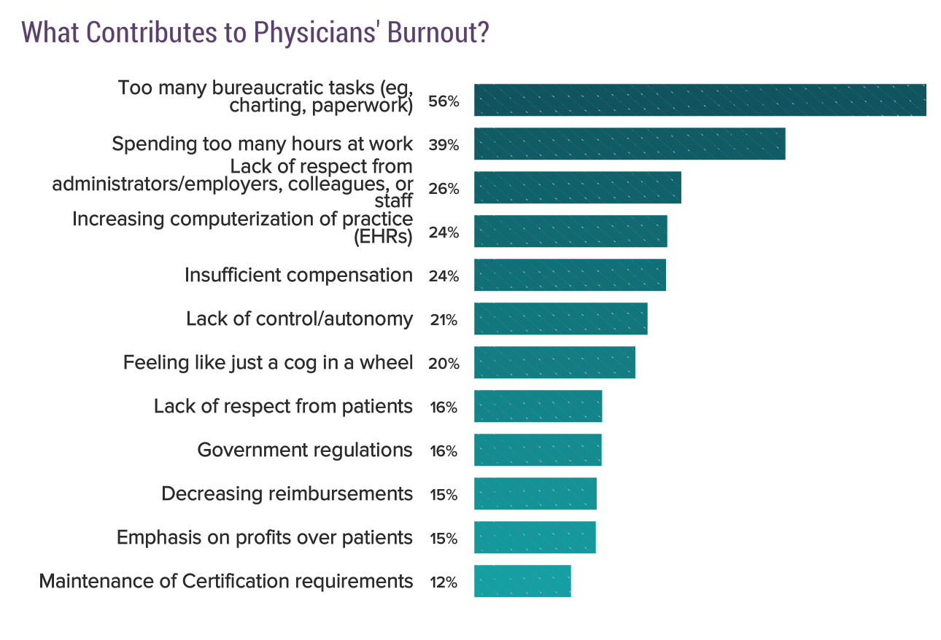
Why is this Happening?²

Slide 6

Why is this Happening?
Internal factors
  “The Hidden Curriculum” of medicine¹
Notes:
“Physician Resilience and Burnout: Can You Make the Switch?” Family Practice Management.
There are four values characteristic of physicians and reinforced in medical training: service, excellence, curative competence, and compassion. Although each one is a virtuous strength and source of pride for physicians, each possesses a destructive “dark side” – deprivation, invincibility, omnipotence, and isolation.
Most physicians are first drawn to the calling, or service aspect of medicine. The ability to make a difference in a person’s health is compelling and rewarding. This expectation of service is reinforced repeatedly throughout training, starting with the Hippocratic Oath. Yet early in a career this sense of service may begin to feel more like duty, and the personal sacrifice it requires may feel more like deprivation, even victimization or martyrdom, when self-sacrifice becomes exhausting. Medical students regularly accept the sacrifice of rigorous and extended training, denying their personal needs, such as sleep and food, to be of service as healers. This expectation of sacrifice can extend to physicians’ families, who are likewise trained to understand the interruptive priority of a medical career. If feelings of deprivation surface, so can a sense of entitlement and an “I deserve it” attitude, which may lead to destructive financial or relationship decisions.
Physicians are committed to the highest standards of excellence, and others expect this of them. In the information age, infinite reservoirs of knowledge and memory are assumed. Zero tolerance for mistakes is common. These expectations breed perfectionism, and the associated lack of acceptance of the potential for error can lead to feelings of invincibility. Safe venues for admitting and discussing error or harm, inadequacy, or loss of control are not common in medical culture. Eventually, physicians who do not discuss their errors with anyone may deny it to themselves, arriving at some other explanation for the outcome.
Physicians value curative competence, and they take responsibility for patient outcomes. But sometimes that outcome is not within the physician’s control. Surgeons are valued on their success and complication rates, often independent of patient complexity; hospitals rely on such measures to enhance their reputation. Such pressures and physicians’ drive to cure can lead to urgency, forcing action when a diagnosis is unclear or fostering discomfort with ambiguity in a clinical presentation. One potential downside of this expectation is a sense of omnipotence and intolerance for ambiguity. Patients who challenge a medical diagnosis or question a treatment plan may be viewed as “difficult” or “noncompliant.” At the same time, mentors and evaluators reinforce the medical student’s self-criticism if he or she is not meeting internal or external standards of competency. Answering “I do not know” is rarely rewarded by educators or patients. Fear of exposure, or “imposter syndrome,” and a sense of inadequacy haunt medical trainees and young physicians. The ongoing emotional distress this tension can create may lead to embracing omnipotence to resolve the cognitive dissonance between expectations and the physician’s recognition of his or her own limitations.
Physicians value compassion, which requires a delicate balance of empathy and appropriate emotional boundaries with patients and their families. Medical trainees may witness fetal demise, childhood chemotherapy, suicide, and chronic disability, as well as the effects of homelessness, addiction, prostitution, and war. The tender heart committed to service and sacrifice and focused on excellence and a commitment to cure quickly learns to set aside the typical empathetic human reaction to such suffering. Yet often we cannot fully forget the face or the profound emotional experience. The discomfort of this reaction may result in suppressing emotions, positive or negative, to the point of what many physicians describe as emotional isolation, a sense of “people all around yet feeling completely alone.”
These values of service, excellence, curative competence, and compassion are interconnected and implicit in medical culture. Physicians retain high levels of public respect because of these values, and they are key to finding meaning and joy in medicine. They also create unspoken expectations, commonly referred to as the “hidden curriculum,” that if unchecked can destroy a career.

Slide 7
Framework to Link Cultural Norms In Medicine with Burnout Factors¹
Positive Value | Negative Potential | Burnout Factors | Potential Interventions
Service | Deprivation | Compassion fatigue, Entitlement | Reframing, Appreciation and gratitude
Excellence | Invincibility | Emotional exhaustion | Mindful self-compassion, Inner critic awareness
Curative Competence | Omnipotence | Ineffectiveness, Cynisism | Self-awareness, Generous listening
Compassion | Isolation | Depersonalization | Connection as community, Silence as energizing

Slide 8
Why Does this Matter?
There is a mental health crisis among doctors that is spiraling out of control, and the ramifications extend beyond the happiness of the individual physician experiencing depression and burnout

Slide 9
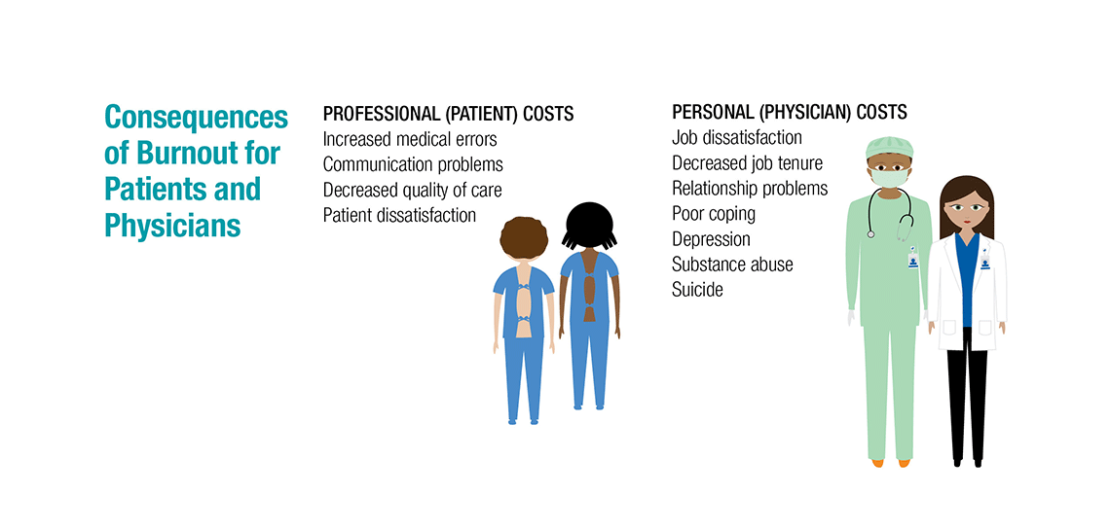
Repercussions of Burnout

Slide 10

What is Resilience?
The ability to bounce back from stressful circumstances³
A triad of beliefs used to weather the storms within the profession¹
  Aligning your practice with the values that support meaning or purpose in your life
  Providing the self-care of adequate nutrition, sleep, exercise, and social interaction
  Developing insight into the behavior and motivation of yourself and others
Notes:
One of the most important qualities that a physician can have
Resilient people do experience stress, but are adaptable and positive in response to change and adversity
Resilient physicians are able to retain their sense of purpose

Slide 11
Techniques for Building Resilience: Mindfulness
“Paying attention in a particular way, on purpose, in the present moment and without judgment” – Jon Kabat-Zinn
Helps physicians listen more carefully to their patients, show more compassion, and approach problems in a fresh, open-minded way
It is especially suited to physicians, because it can help counteract the worrying, perfectionism and self-judgment that are so common among doctors³
Notes:
Jon Kabat-Zinn is the creator of the Stress Reduction Clinic and the Center for Mindfulness in Medicine, Health Care, and Society at the University of Massachusetts Medical School.

Slide 12
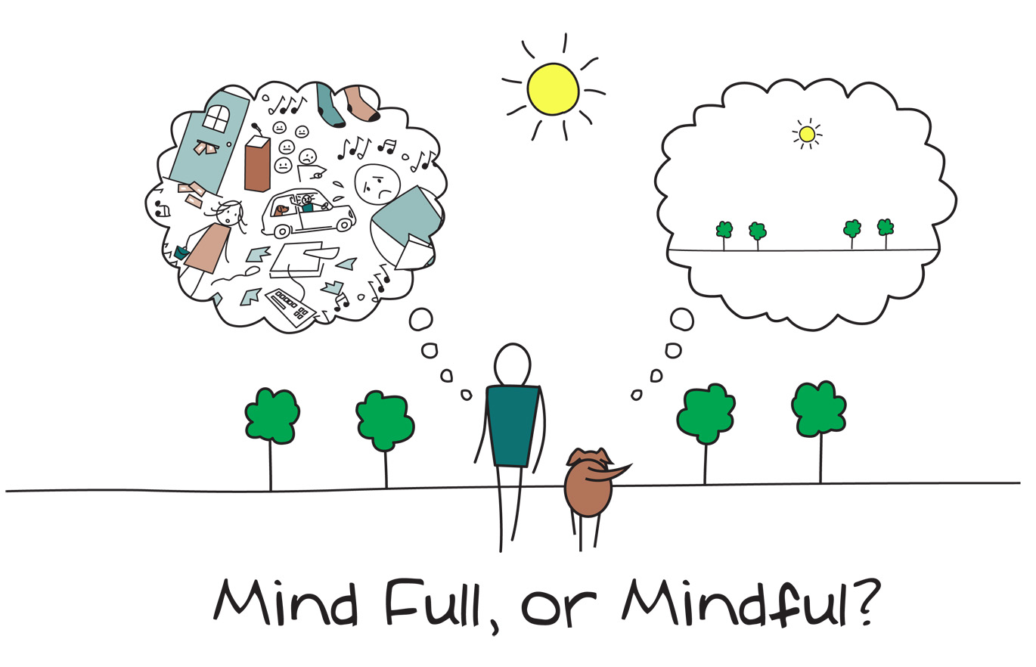
Mindfulness

Slide 13
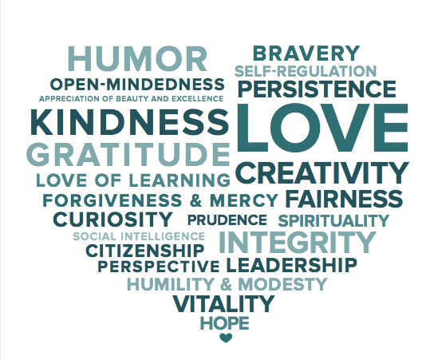
Techniques for Building Resilience: Positive Psychology
Bookend your day
  Gratitude upon awakening
  Three good things before going to bed
Gratitude letter and visit
Acts of kindness
Notes:
Positive Psychology is the scientific study of what makes life most worth living. The field is founded on the belief that people want to lead meaningful and fulfilling lives, to cultivate what is best within themselves, and to enhance their experiences of love, work, and play.

Slide 14

Positive Psychology
“The negative screams at you but the positive only whispers.” – Barbara Fredrickson
Notes:
So intentionally seek out the positive.

Slide 15

Techniques for Building Resilience: Self-Care
Regular exercise
Balanced diet
Adequate sleep
Investing in relationships
Spiritual growth

Slide 16

Self-Care
“You can never meet your potential until you truly learn to love yourself.” – Teresa Collins

Slide 17

Building Resilience³
Make connections
Avoid seeing crises as insurmountable problems
Accept that change is part of living
Move toward your goals
Take decisive actions

Slide 18

Building Resilience³
Look for opportunities for self-discovery
Nurture a positive view of yourself
Keep things in perspective
Maintain a hopeful outlook
Take care of yourself
Notes:
Find what works for you. Relationships are vital. We cannot do this alone. But ultimately we need to each find what provides balance for us in this oftentimes difficult career.

Slide 19
References
1 Nedrow, A, Steckler, N, and Hardman, J. “Physician Resilience and Burnout: Can You Make the Switch?” Family Practice Management. January 2013; 25-30.
2 https://www.medscape.com/slideshow/2018-lifestyle-burnout-depression-6009235#27
3 https://wellmd.stanford.edu/healthy/resilience.html

